Slide 1
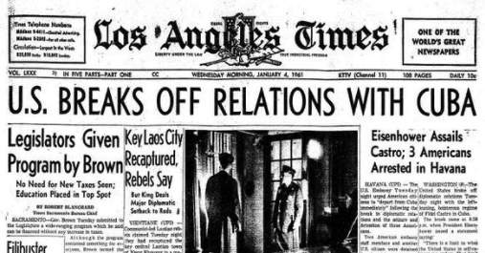
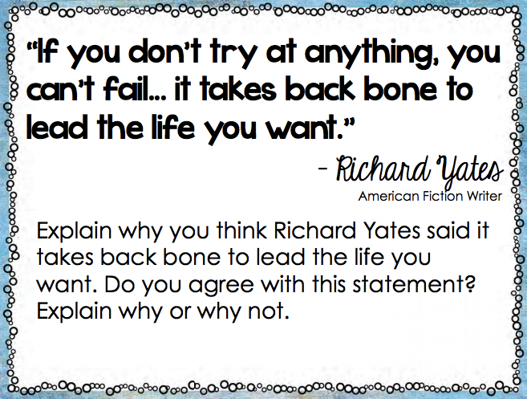
Tuesday, January 3rd Day 1
This Day in History: 1969 US severs diplomatic relations with Cuba.
Warm Up
(3 sentence MINIMUM)

Slide 2
Engineering Challenge
Challenge #1:
Build a structure with one cube as a base. Yes, one cube!
Do NOT build this→
It is just an example.

Slide 3
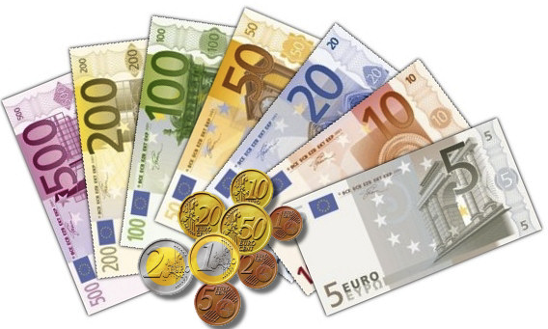
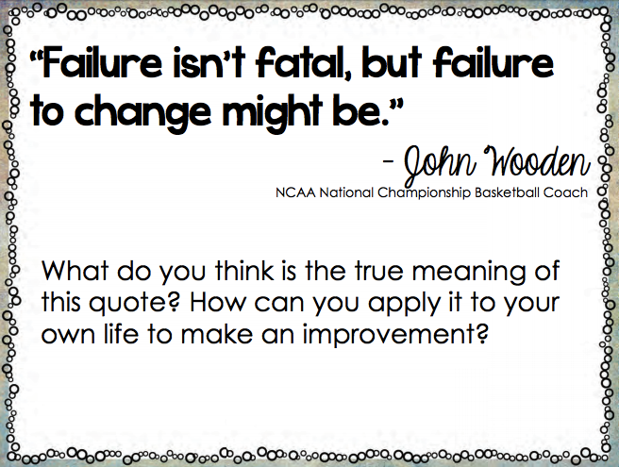
Wednesday, January 4th Day 2
This Day in History: 1999
The euro debuts
Warm Up
(3 sentence MINIMUM)

Slide 4
Problem of the Day

Slide 5
Engineering Challenge
Challenge #2:
Using any size base, build the tallest structure possible.

Slide 6
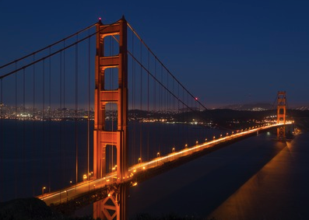
Thursday, January 5th Day 3
This Day in History: 1933
The Golden Gate Bridge is born
Warm Up
(3 sentence MINIMUM)
Tenacity: Perseverance; never letting go; never letting up

Slide 7
Problem of the Day

Slide 8
Engineering Challenge
Challenge #3:
Feats of balance. Make something stick out in an amazing way!
Do NOT build this→
It is just an example.

Slide 9
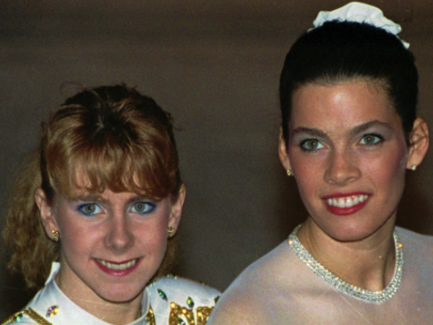
Friday, January 6th Day 4
This Day in History: 1994
Skater Nancy Kerrigan is attacked
Warm Up
(3 sentence MINIMUM)

Slide 10
Problem of the Day

Slide 11
Engineering Challenge
Challenge #4:
What can you build with just one cup as the base?
Do NOT build this→
It is just an example.

